Slide 1
Project Title : AI Invoice Management System for finance.
Team No : 27
Team Member Details :
Shanna P - 691285
Deva Poornambiga Jeyaprakash - 690008
Navaneethan R - 690641
Robin Rohith V - 691277

Slide 2


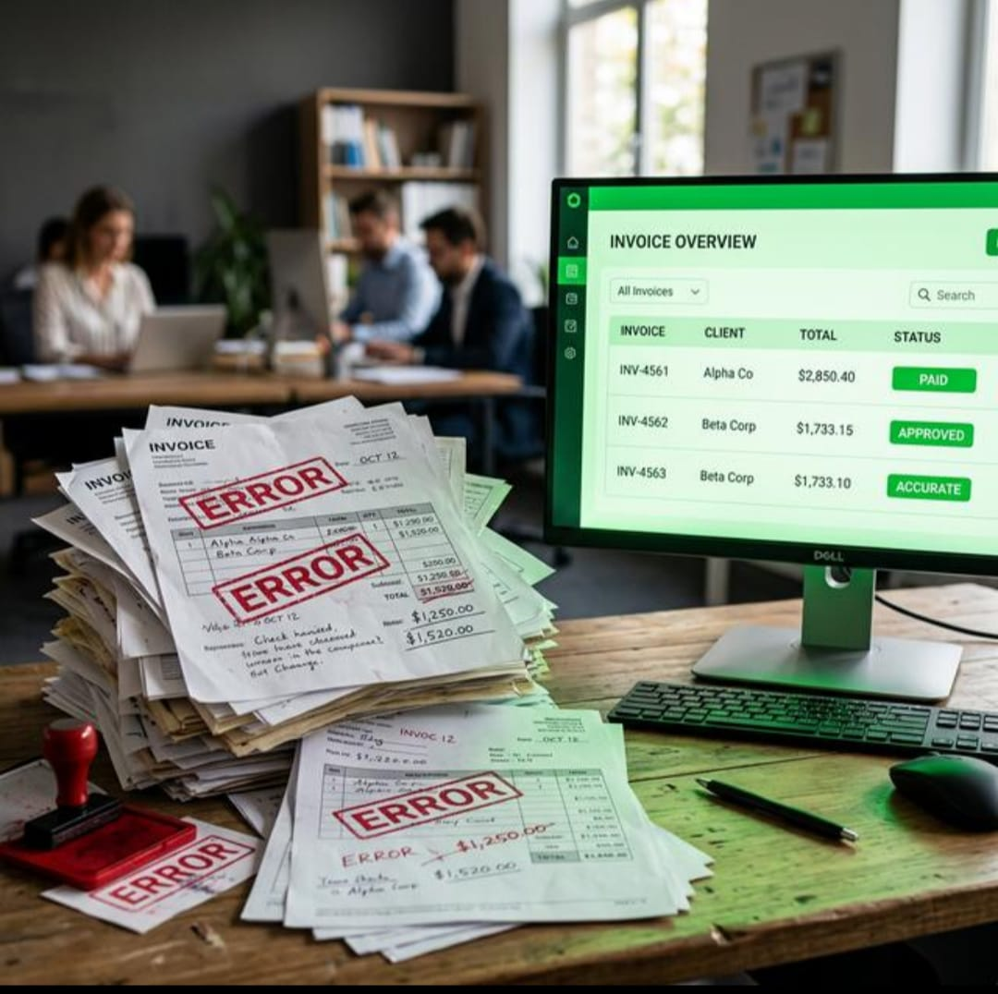
PROBLEM STATEMENT
AI Invoice Management System
Manual entry slows every payment decision.
Human errors create duplicate records and missed deadlines.
Different invoice formats make the work hard to scale.
SDG 9 : Industry, Innovation and Infrastructure

Slide 3
PROPOSED SOLUTION
AI Invoice Management System
One upload creates a verified invoice record
Read PDFs, images, and scanned invoices.
Extract invoice fields automatically.
Check whether required fields are present.
Detect duplicate invoices.
Verify totals, taxes, and line items.
Track payment due dates.
Alert users about overdue or suspicious invoices.
Store structured invoice information in a database.
Manual correction is also available.

Slide 4
WORKFLOW
AI Invoice Management System
AA
O
Upload Invoice
AI Reads the Invoice
Automatic Verification
Payment Remainder
Organize

Slide 5

EXISTING SOLUTION
AI Invoice Management System
Manual data entry
Slow approval process
Duplicate invoice error
Missed payment deadlines

Slide 6
NOVELTY
AI Invoice Management System
Duplicate and fraud checks stay advisory, but visible
Compare each new invoice against stored records using vendor, invoice number, and amount .
Match
Flag duplicate invoices before they become duplicate payments
Observe
Surface unusual amounts and bank-detail changes for human review
Review
Keep the audit trail visible instead of hiding uncertainty.

